Slide 1
NUTRITION SERVICE HIGHLIGHTS sy 18-19
A QUICK RECAP OF SOME FUN AND PROUD ACCOMPLISHMETNS IN OUR KITCHENS THIS PAST SCHOOL YEAR.

Slide 2
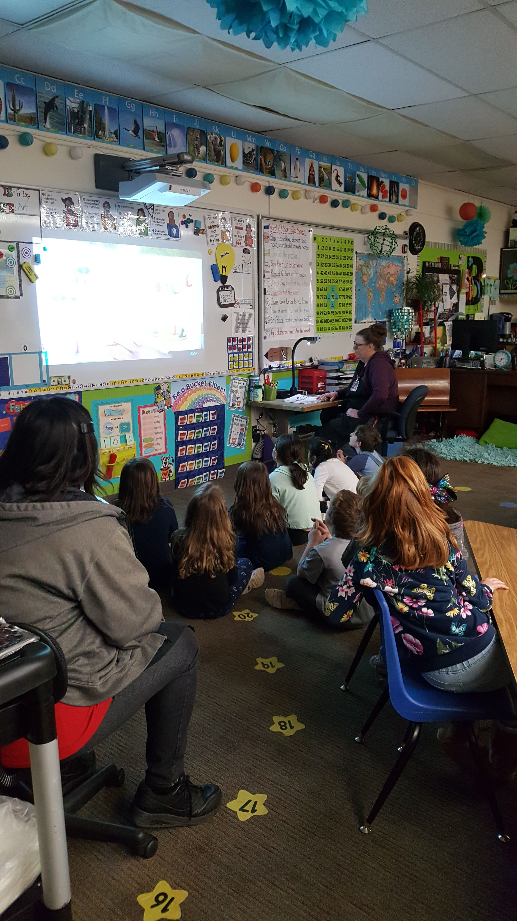
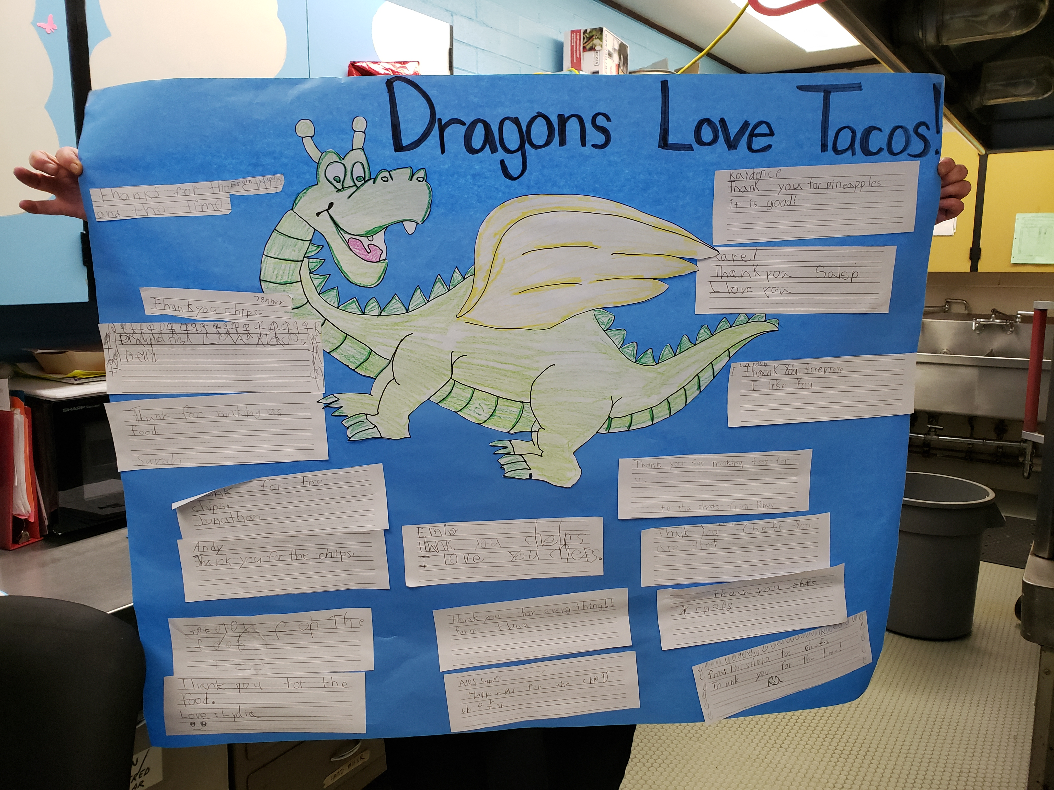
Chef in the classroom
This year we started a new program called Chef in the Classroom. For this experience we took a book that was centered around food, went to a classroom and read the book, then did a food activity. For this year we chose the book “Dragons Love Tacos” and after the reading we invited the students to come up and create their own salsa for an afternoon snack!
The students really enjoyed this experience and even tried some new food items as well!
We completed 13 Chef in the Classrooms at WPS and 1 with the whole school at Yale. We are looking forward to continuing this next year with new books and experiences

Slide 3
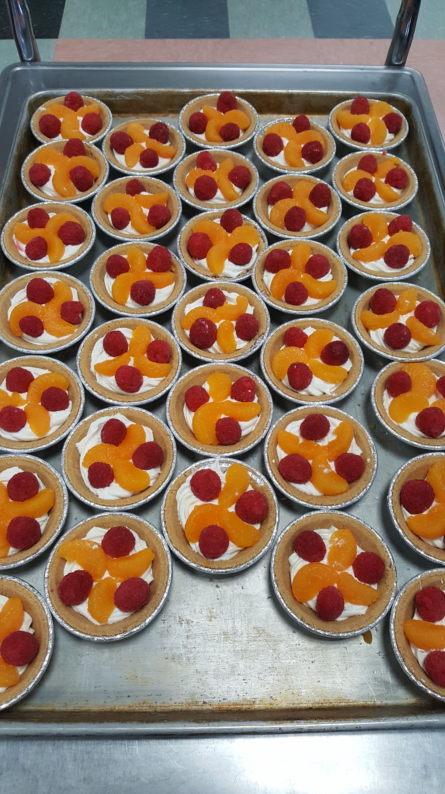
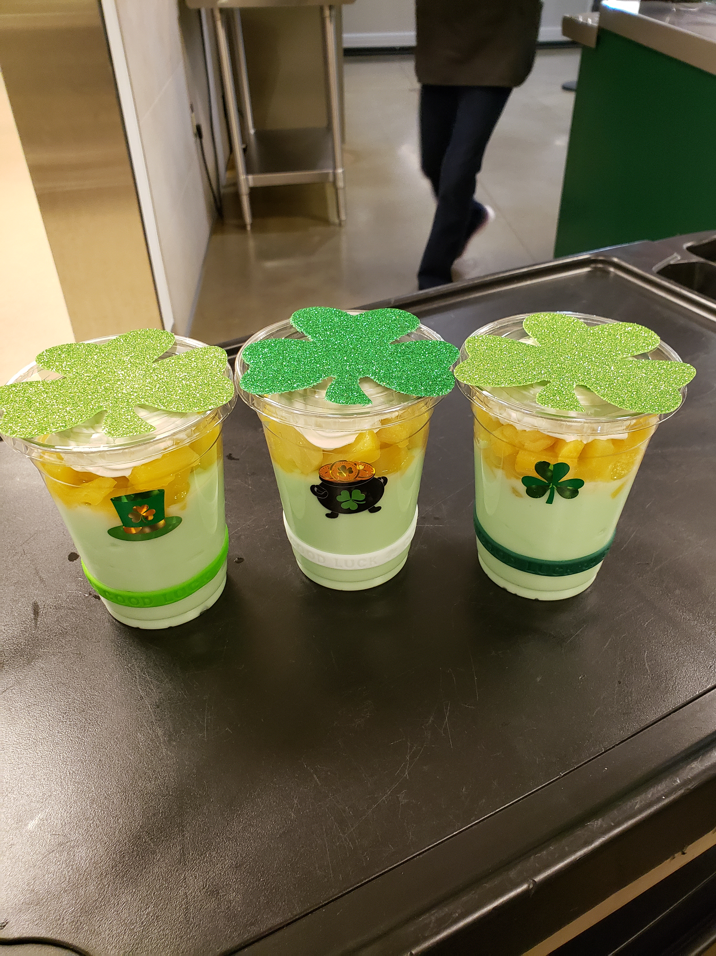
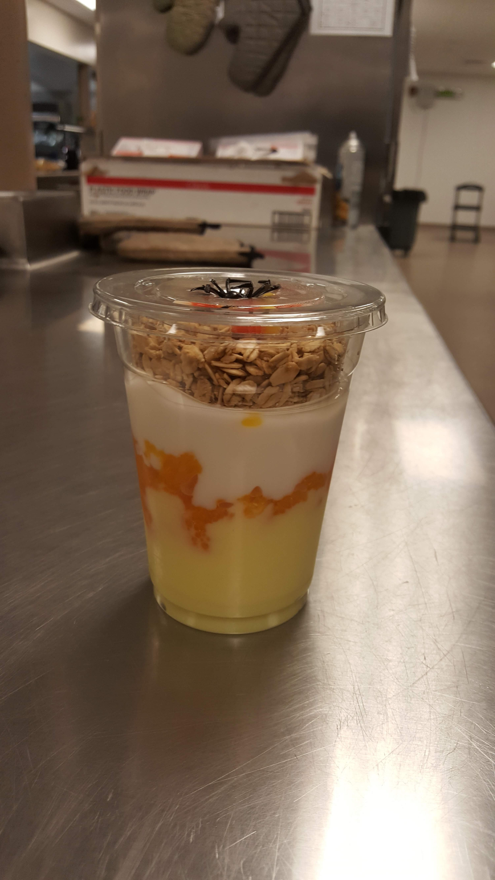
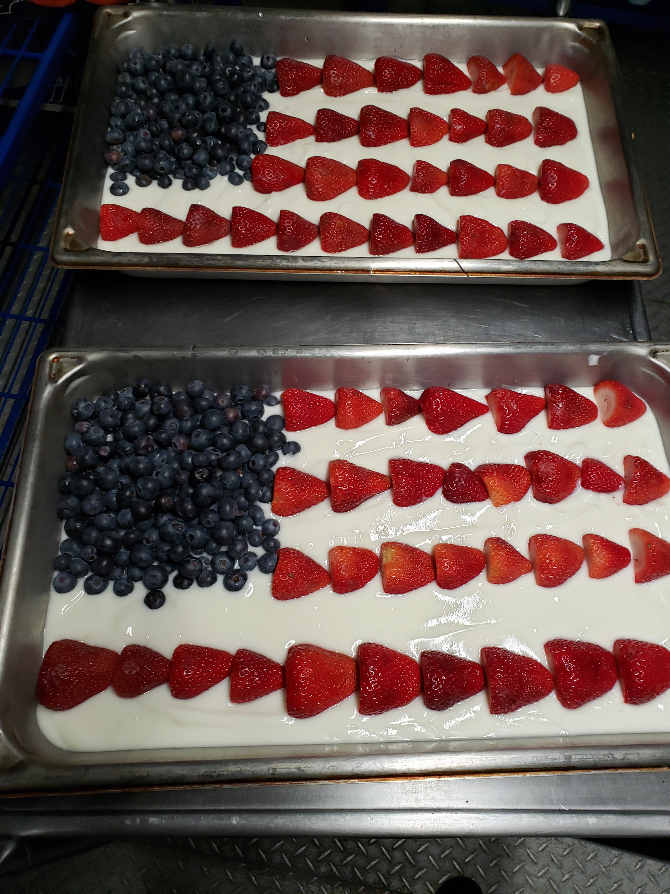
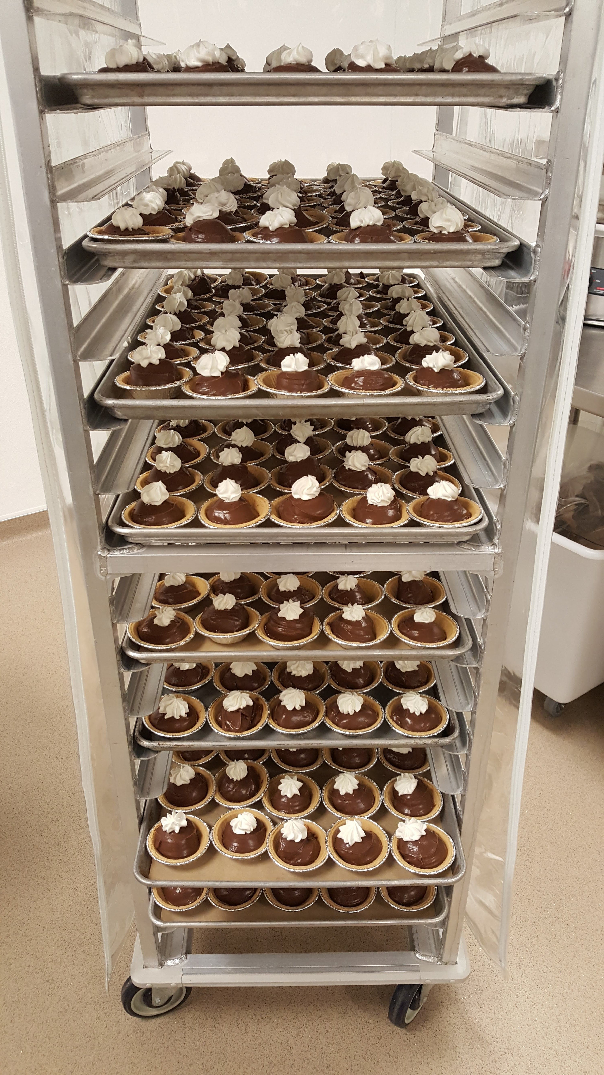
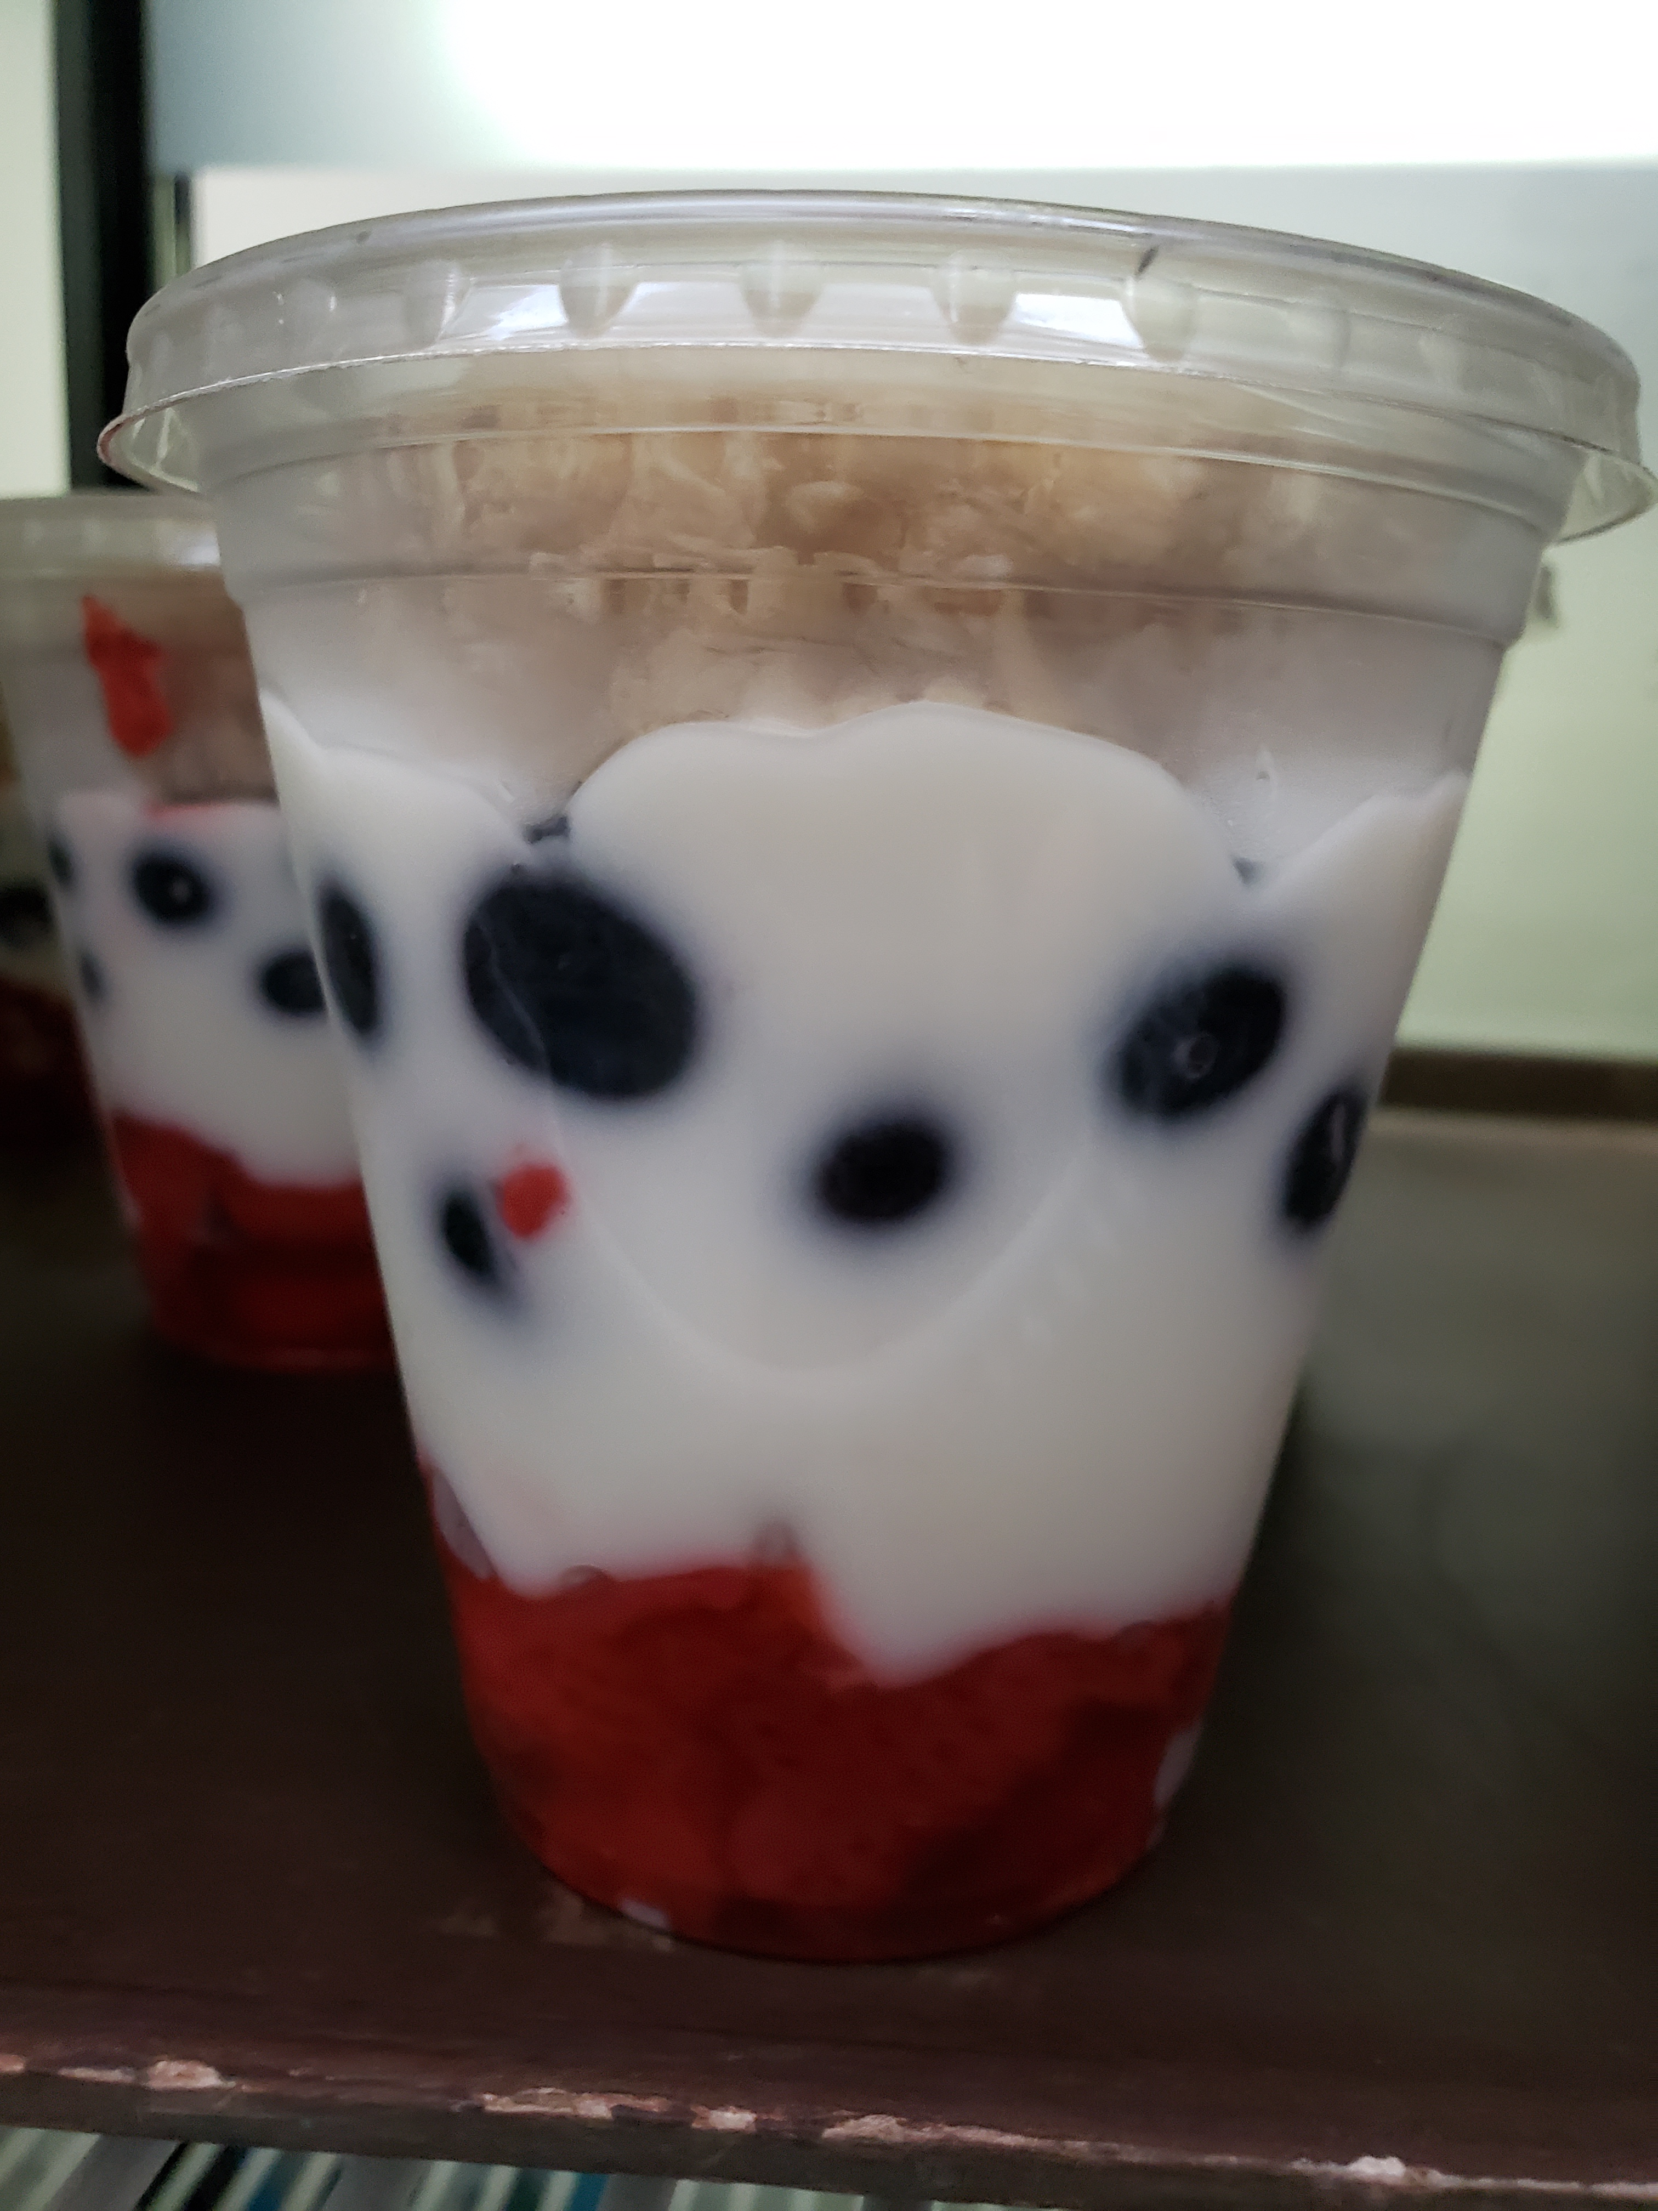
HOLIDAY FUN!
One of my favorite things about this amazing staff is how much they try to make sure lunch is fun and exciting. One thing we did this year is focus on holidays. We did different small, yet noticeable changes with some of our regular menu items. The students did notice and shared their appreciation that we were trying to make lunch fun and seasonal!
St Patrick's Day!
Thanksgiving
desserts!
Halloween Parfaits!
Memorial Day!

Slide 4
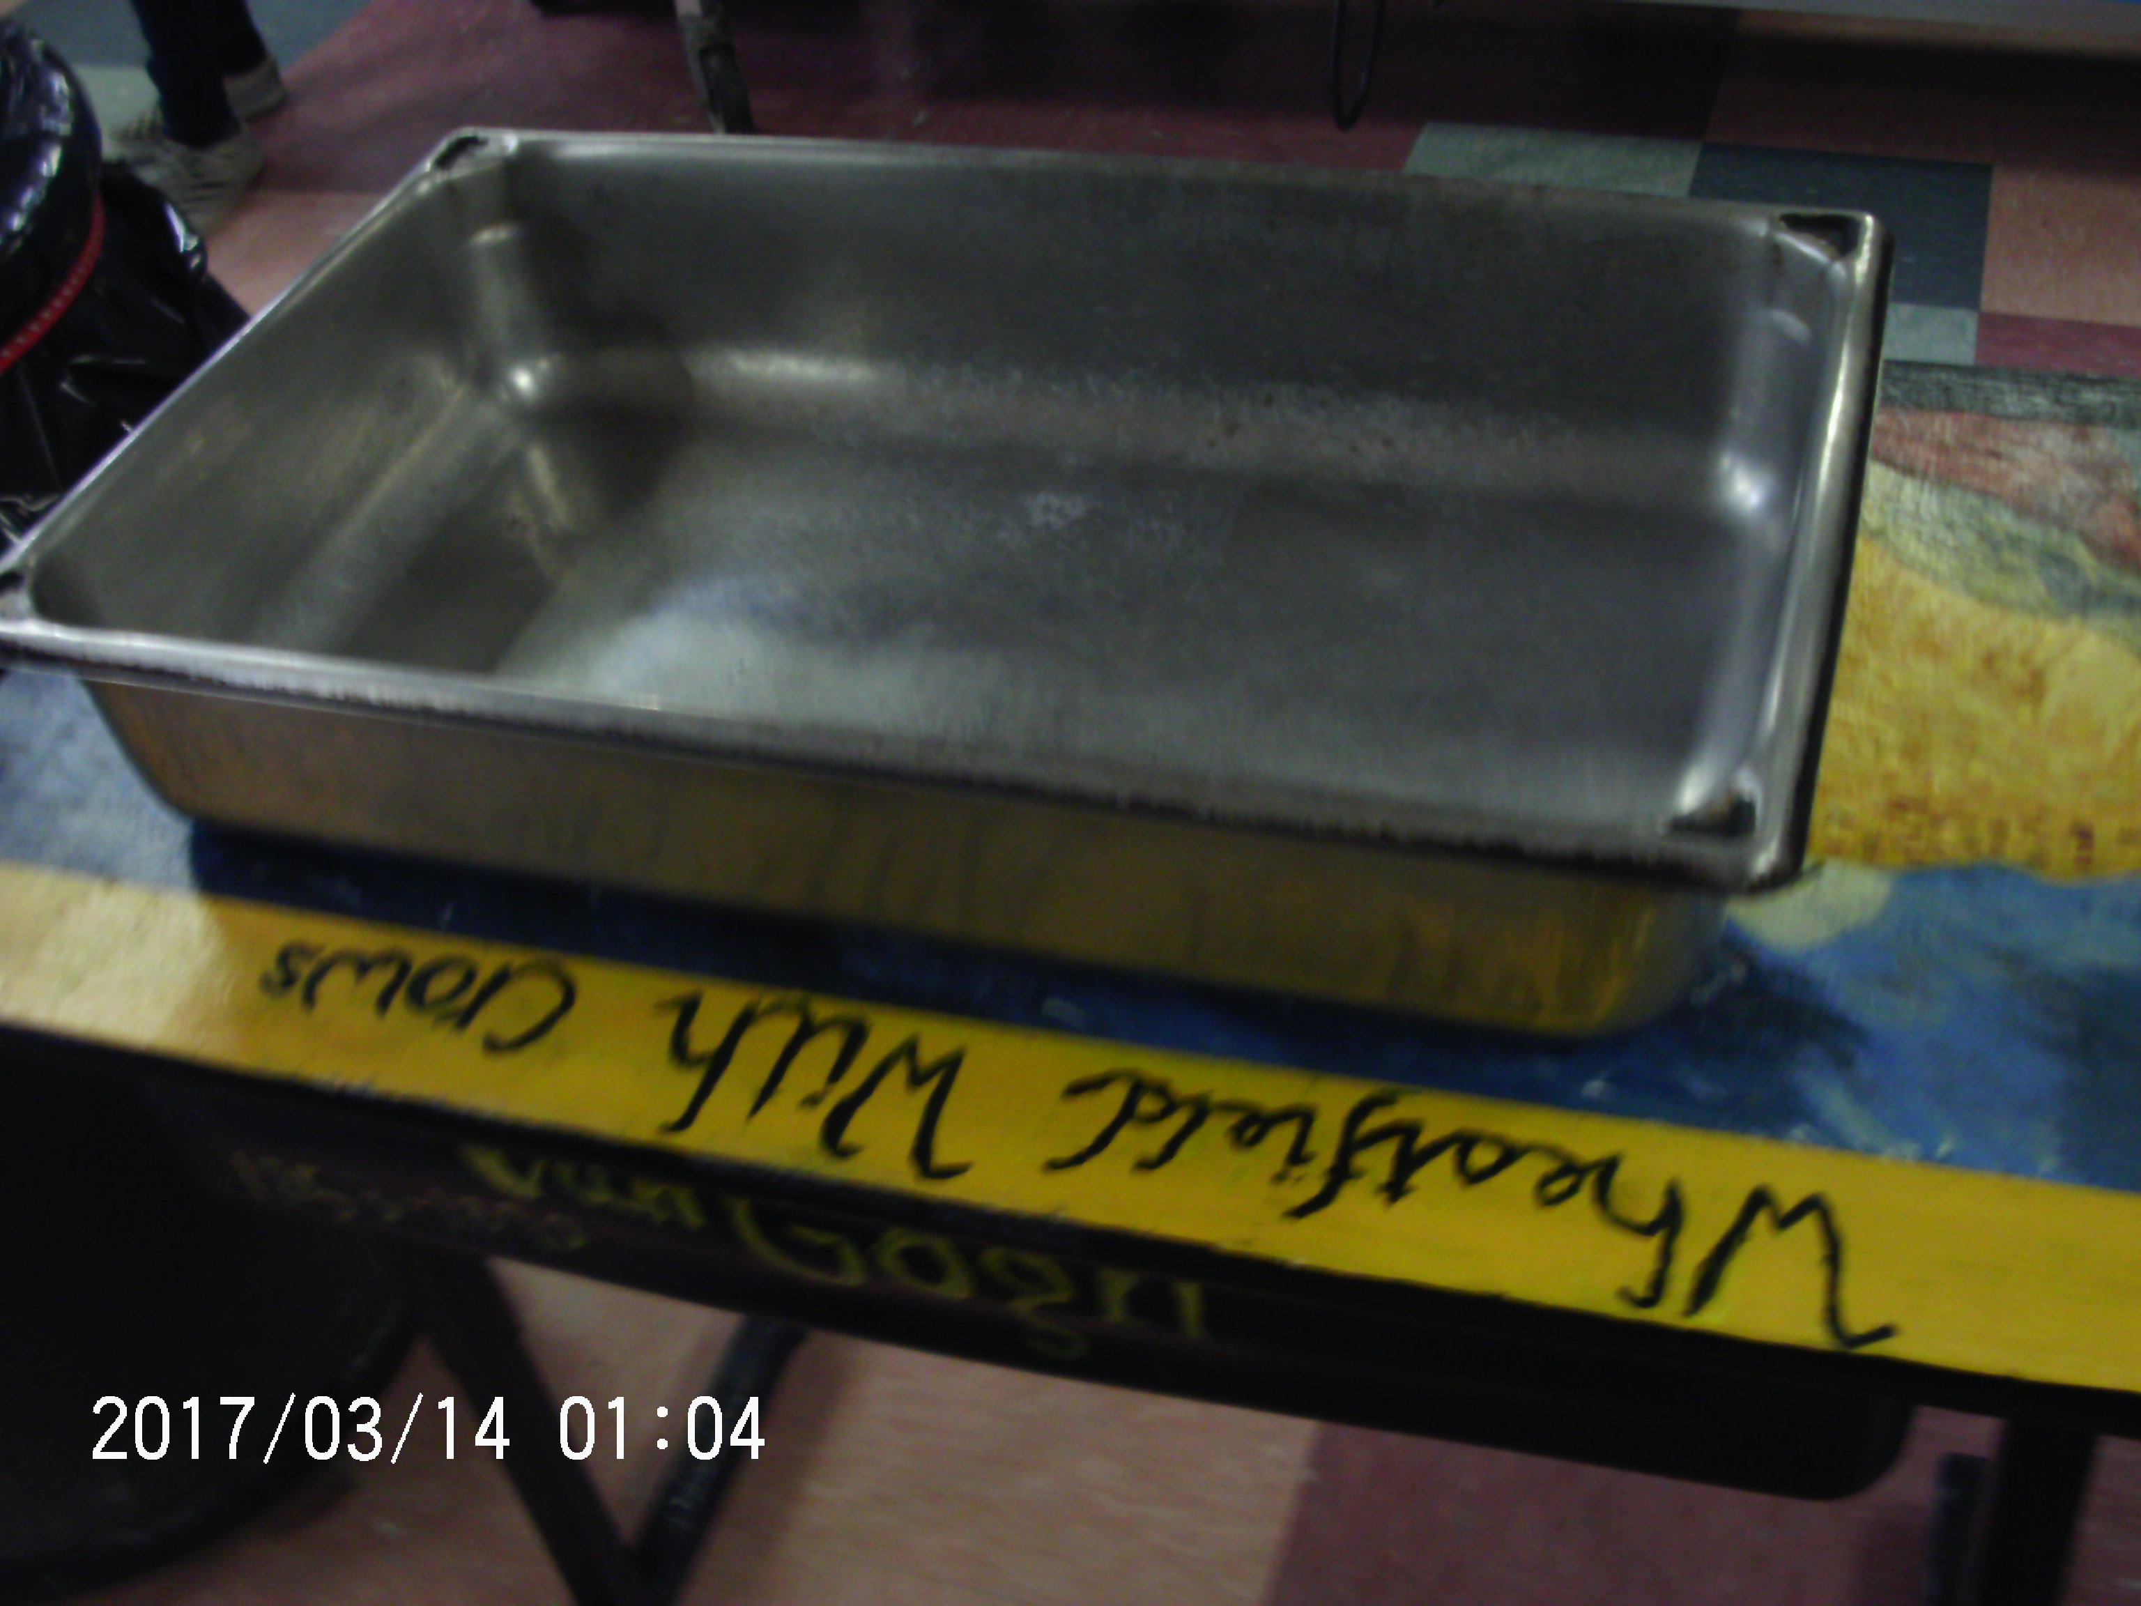
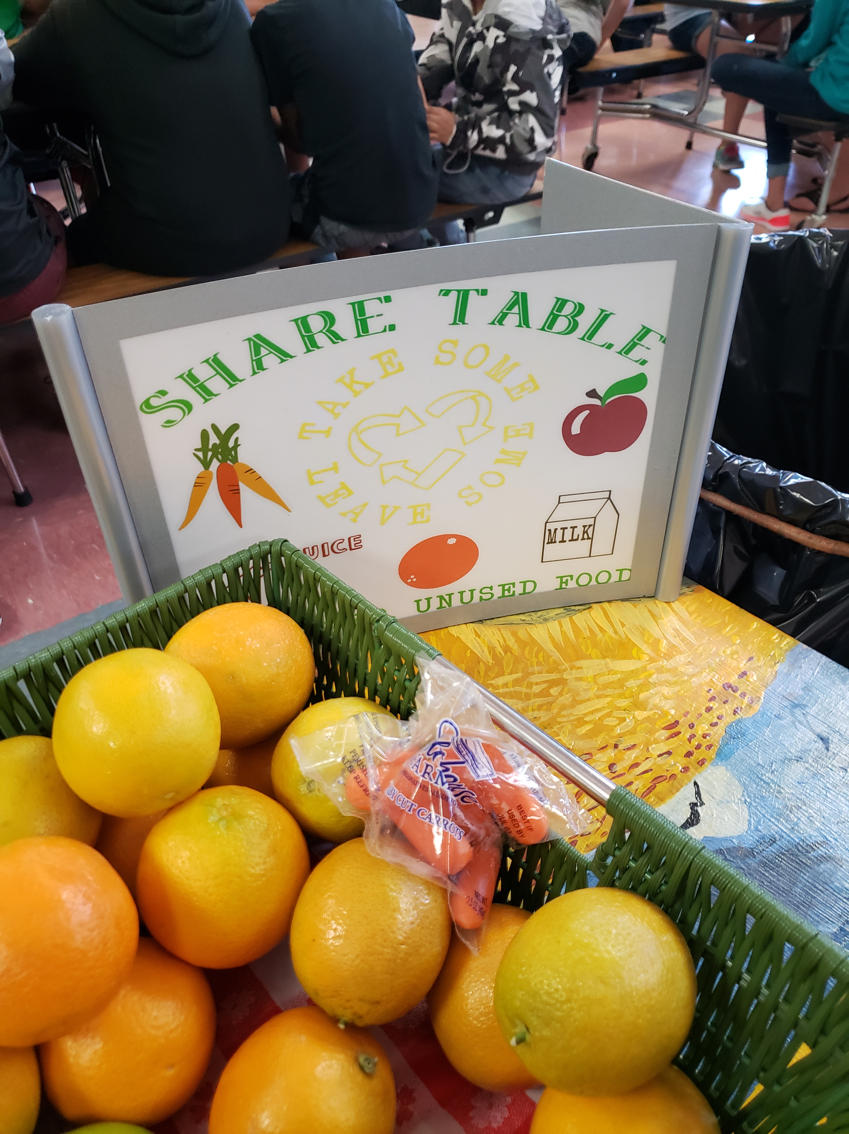
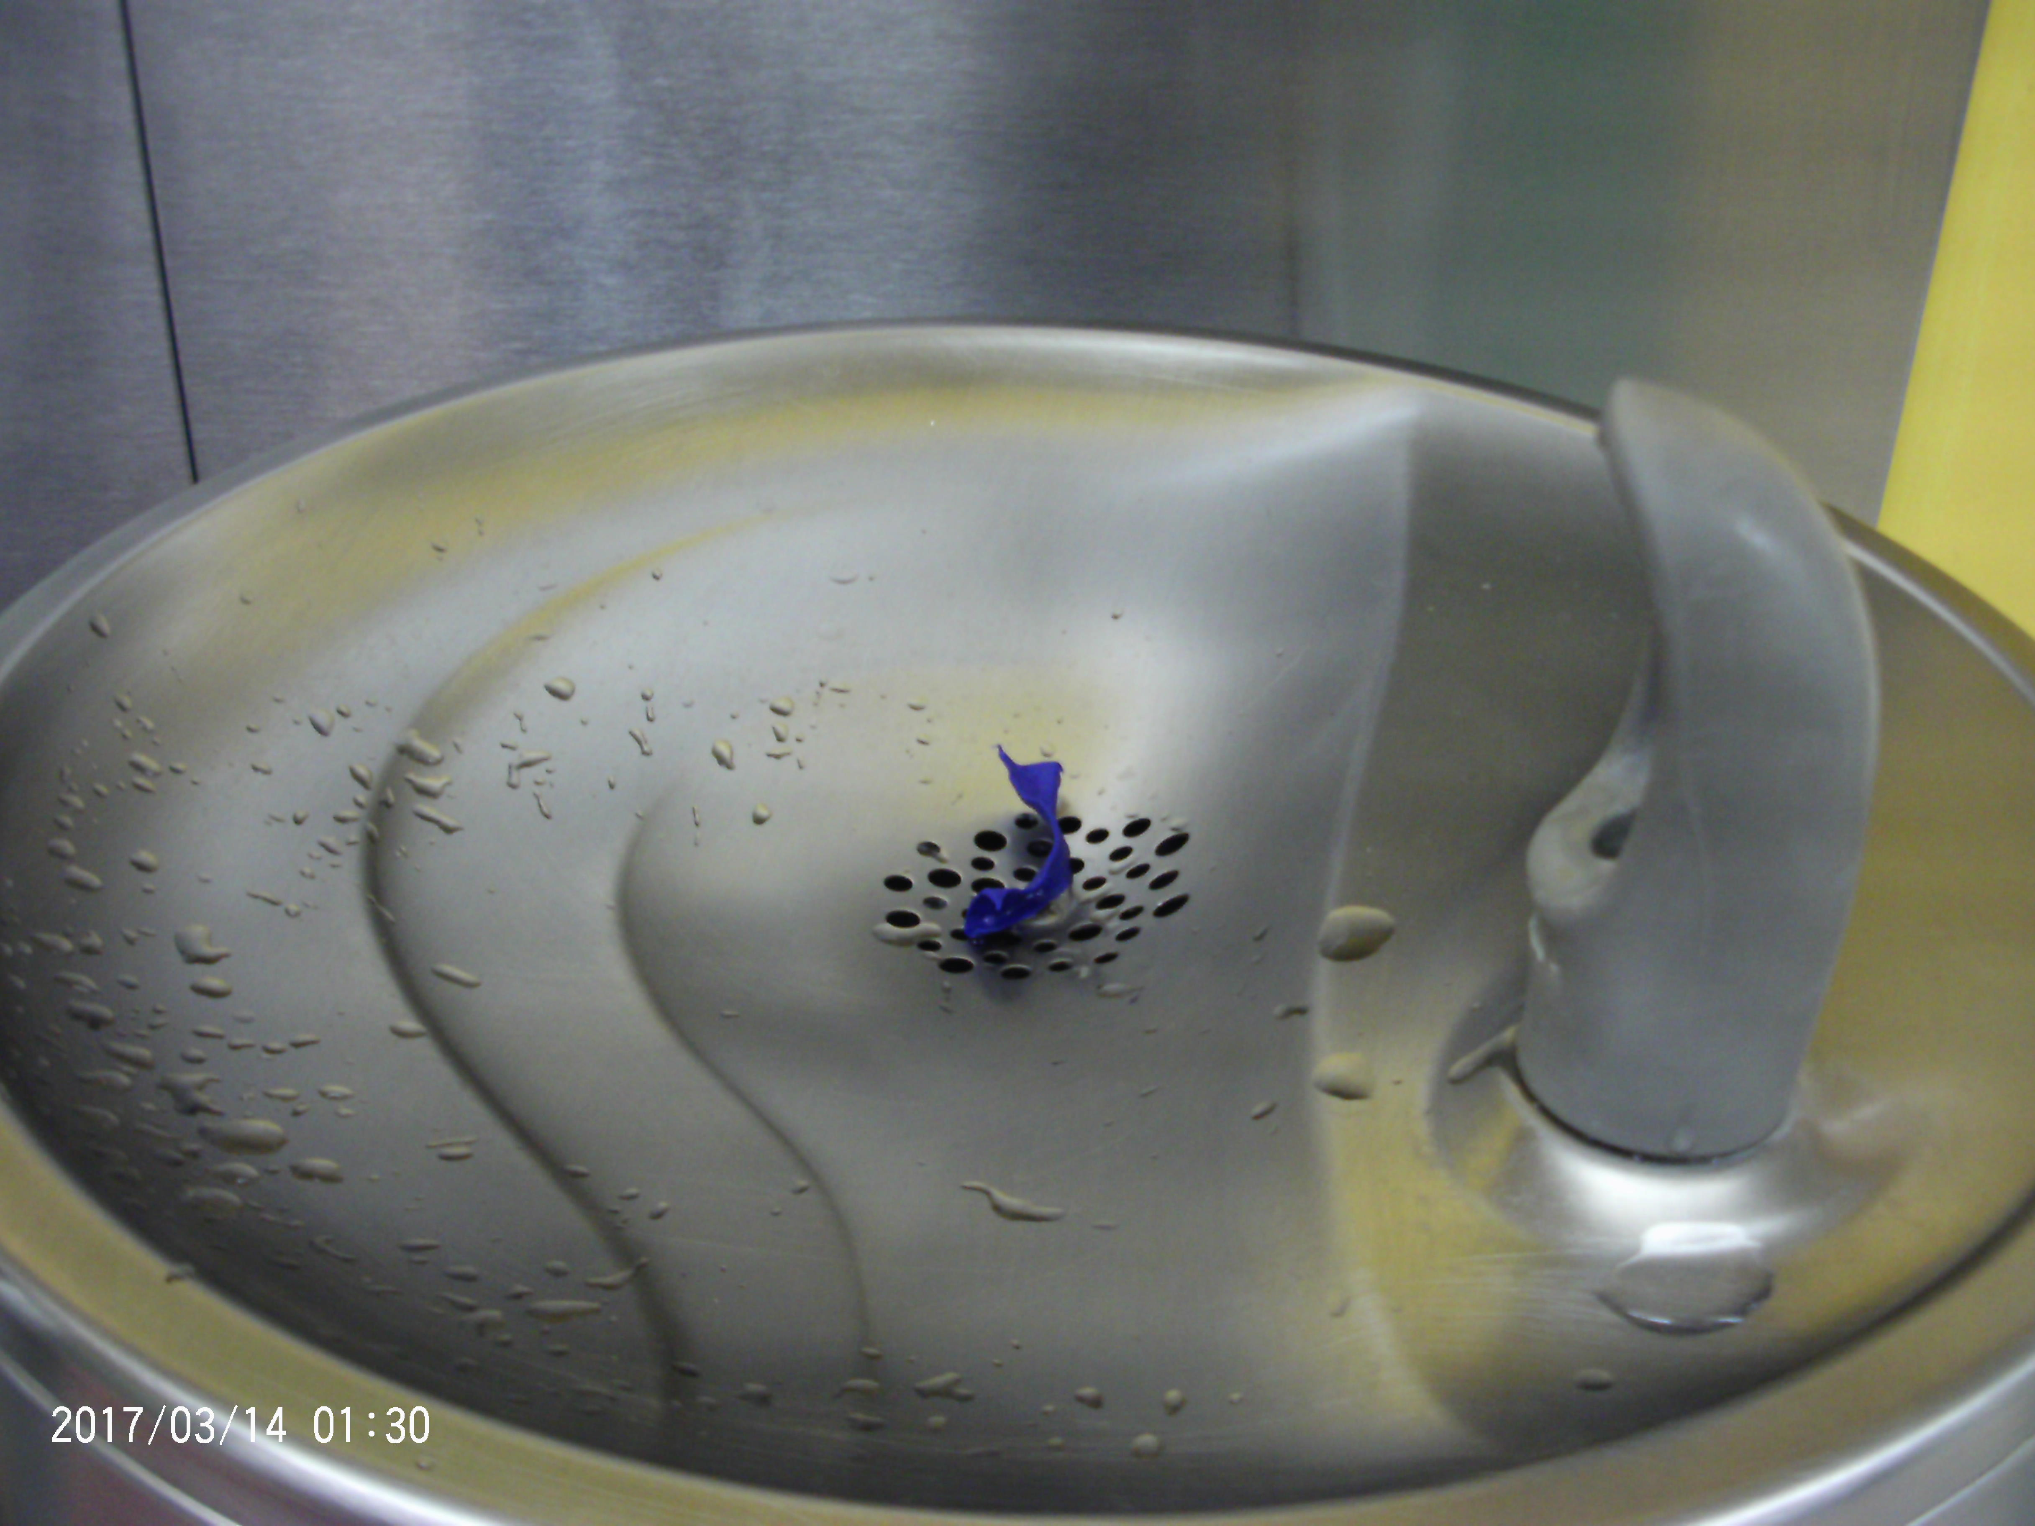
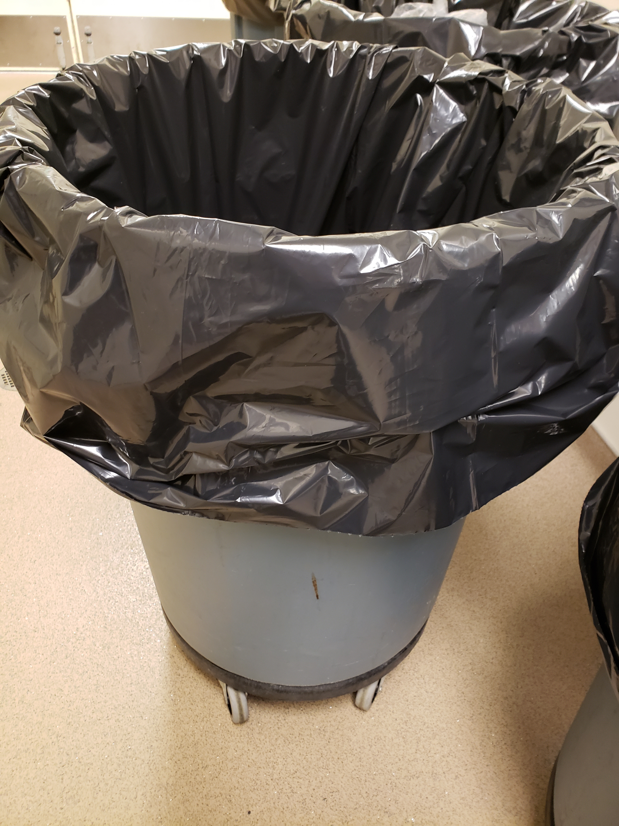
Captured wms
Before: The share table was plain, boring and overlooked. The students thought we needed to do a make over.
After: We got a new basket and made a new sign to help make the share table stand out.
This year we did out Capture Event at Woodland Middle School again. We had a lot of staffing changes throughout the year and we wanted to make sure that the things we improved were not falling through the cracks.
The students were great in not only giving their opinion but solutions as well.
Some examples are on the left.
Problem: The water fountain always had kids putting messes and food, deterring students from using it for drinking.
Solution: Placed a garbage can near the water fountain so if people needed to get rid of things they had a easy chance to do it.

Slide 5
FREE BREAKFAST WEEK!
National School Breakfast Week was March 4th – 8th 2019. We celebrated by making lunch free to all students regardless if they were free, reduced or paid. It gave students a chance to try breakfast without worrying about the cost.
Schools saw an increase but the biggest increases were WPS and WHS feeding about 100 additional students a week!
We saw an increase in breakfast counts for the rest of the year after doing this promotion.

Slide 6
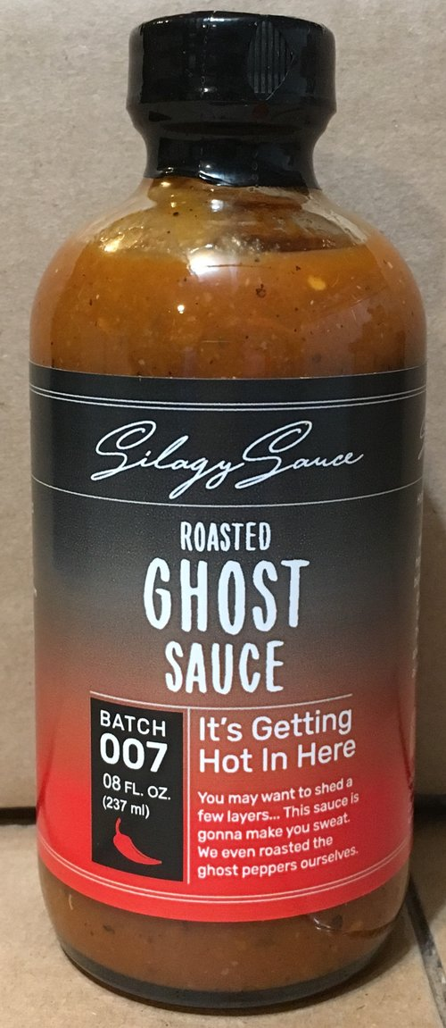
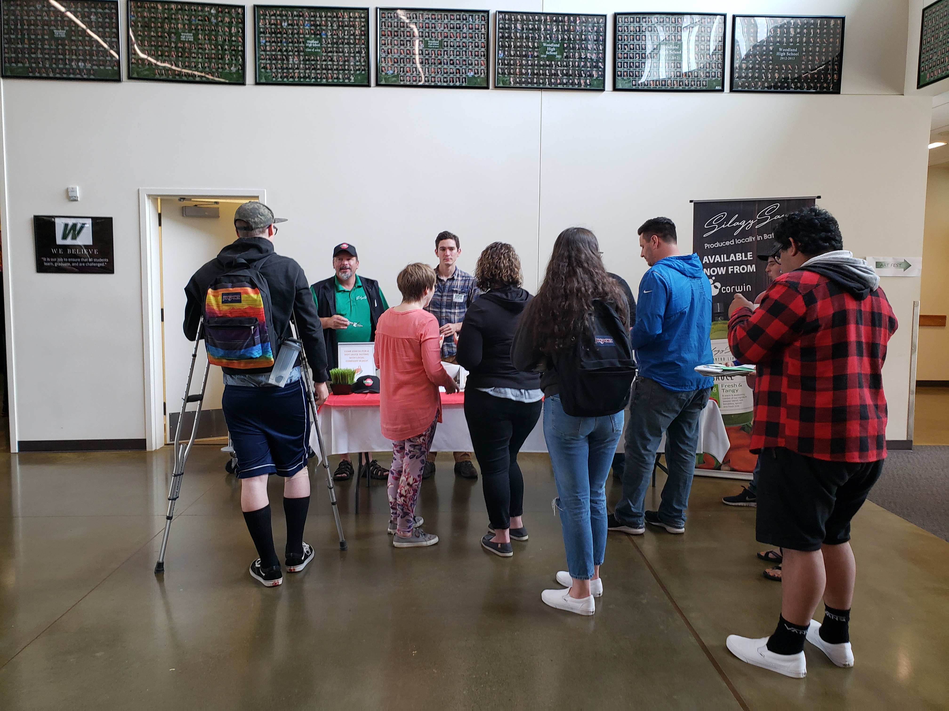
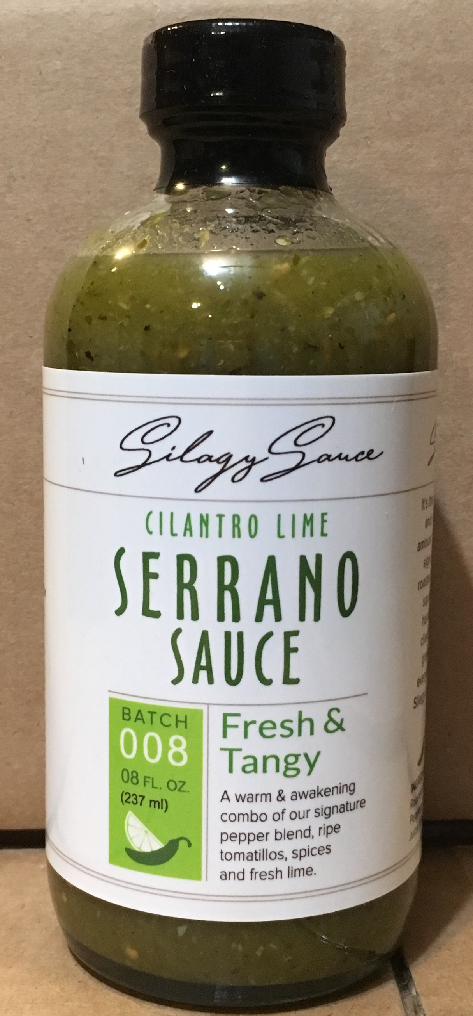
Getting saucy at woodland high school
Through one of our local vendors we were able to bring in a local hot sauce made and produced out of Battle Ground. I invited the company to come out and do a taste test on lauch day to get the students (and staff!) excited about this opportunity.
The favorite by far was the Ghost Pepper hot sauce. This wasn’t available yet, but we will be getting it next year as it was the most popular request we had!

Slide 7
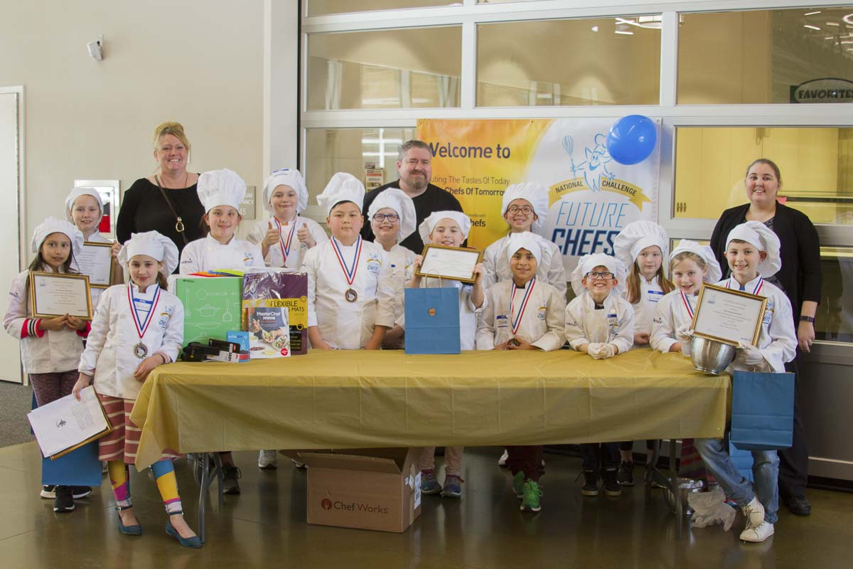
Future chef
This year we had a record 15 contestants for Future Chef. The theme this year was “Healthy Mexican”.
This year we had best of categories with an overall winner The winning recipes for the categories were as follows:
Originality: Sopresa Soup by Apple Rhuman (2nd Grade)
Easy Preparation: Sweet Potato, Black Bean & Chicken Quesadilla by Treb Lawley (5th grade)
Healthy: Salsa with Chips by Josue Martinez (3rd grade)
Kid Friendly: Doritos Taco Bake by Jamison Moultrie (3rd grade)
Taste: Chicken Tacos Lettuce Wrap with Mexican Corn by Winston Ann (4th grade)
Our GRAND PRIZE winner was 4th grader Gina Ek with her fish tacos!

Slide 8
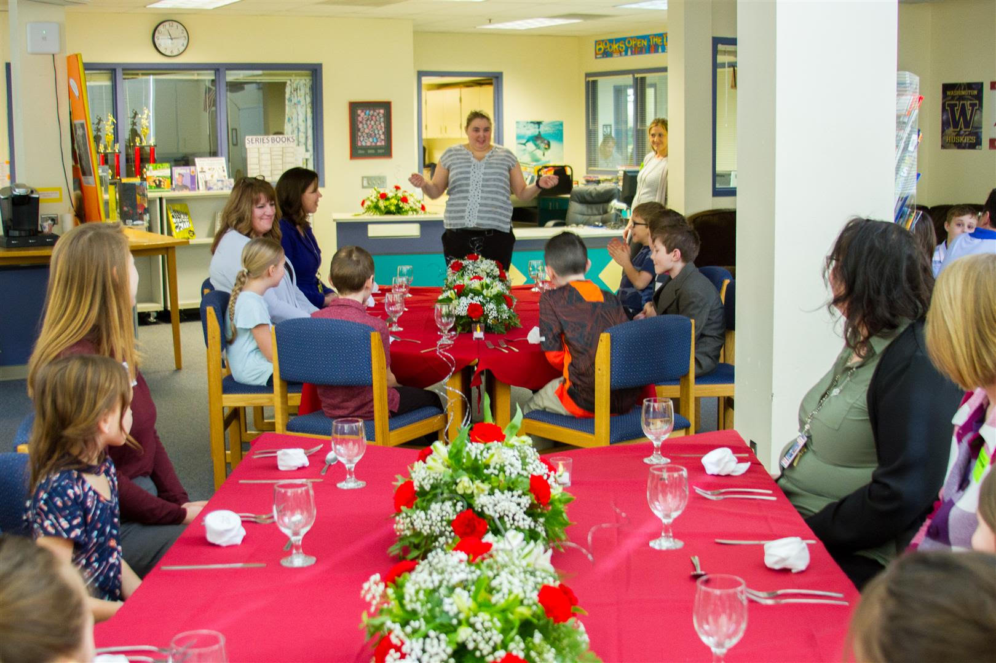
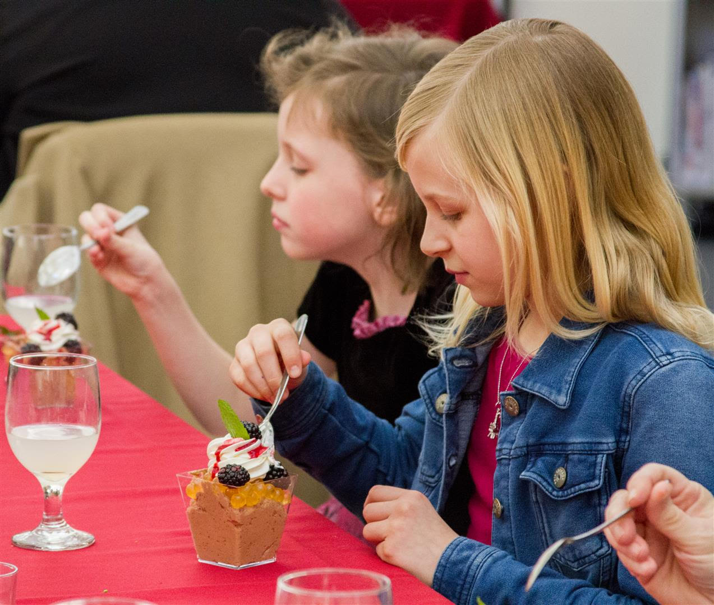
FINe dining at wis
We were excited to host this years Fine Dining in the Library with Rachel Volk’s classroom
Our Sodexo regional Chef, Chef Dave came down to create an exquisite meal consisting of BBQ Chicken Pull Aparts, Grilled Chicken Parmesan Cauliflower Risotto with Basil Oiln and a Chocolate Mousse with fresh berries and mango pearls
The students (and adults) enjoyed their fine dining meal and a chance to use their manners as well.
We are looking forward to extending this program to make it even bigger next year!

Slide 9
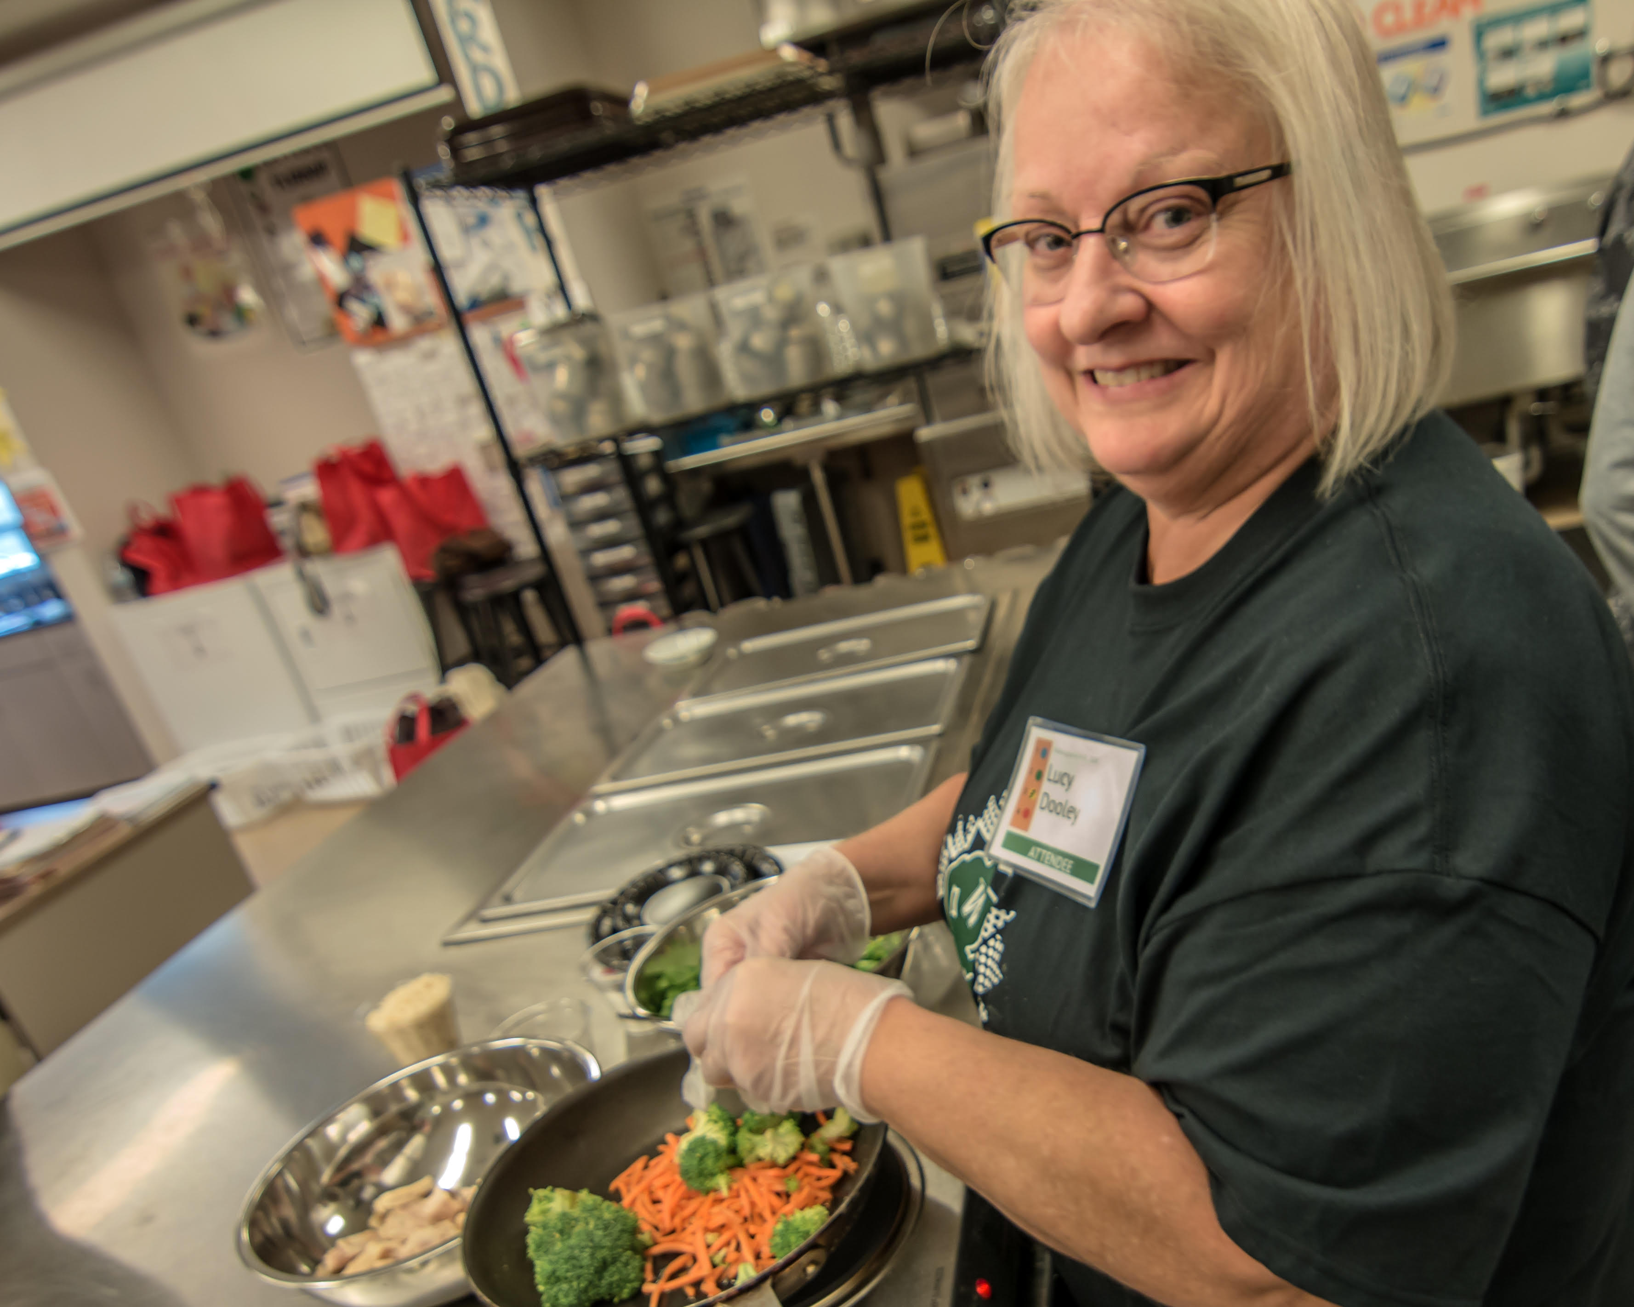
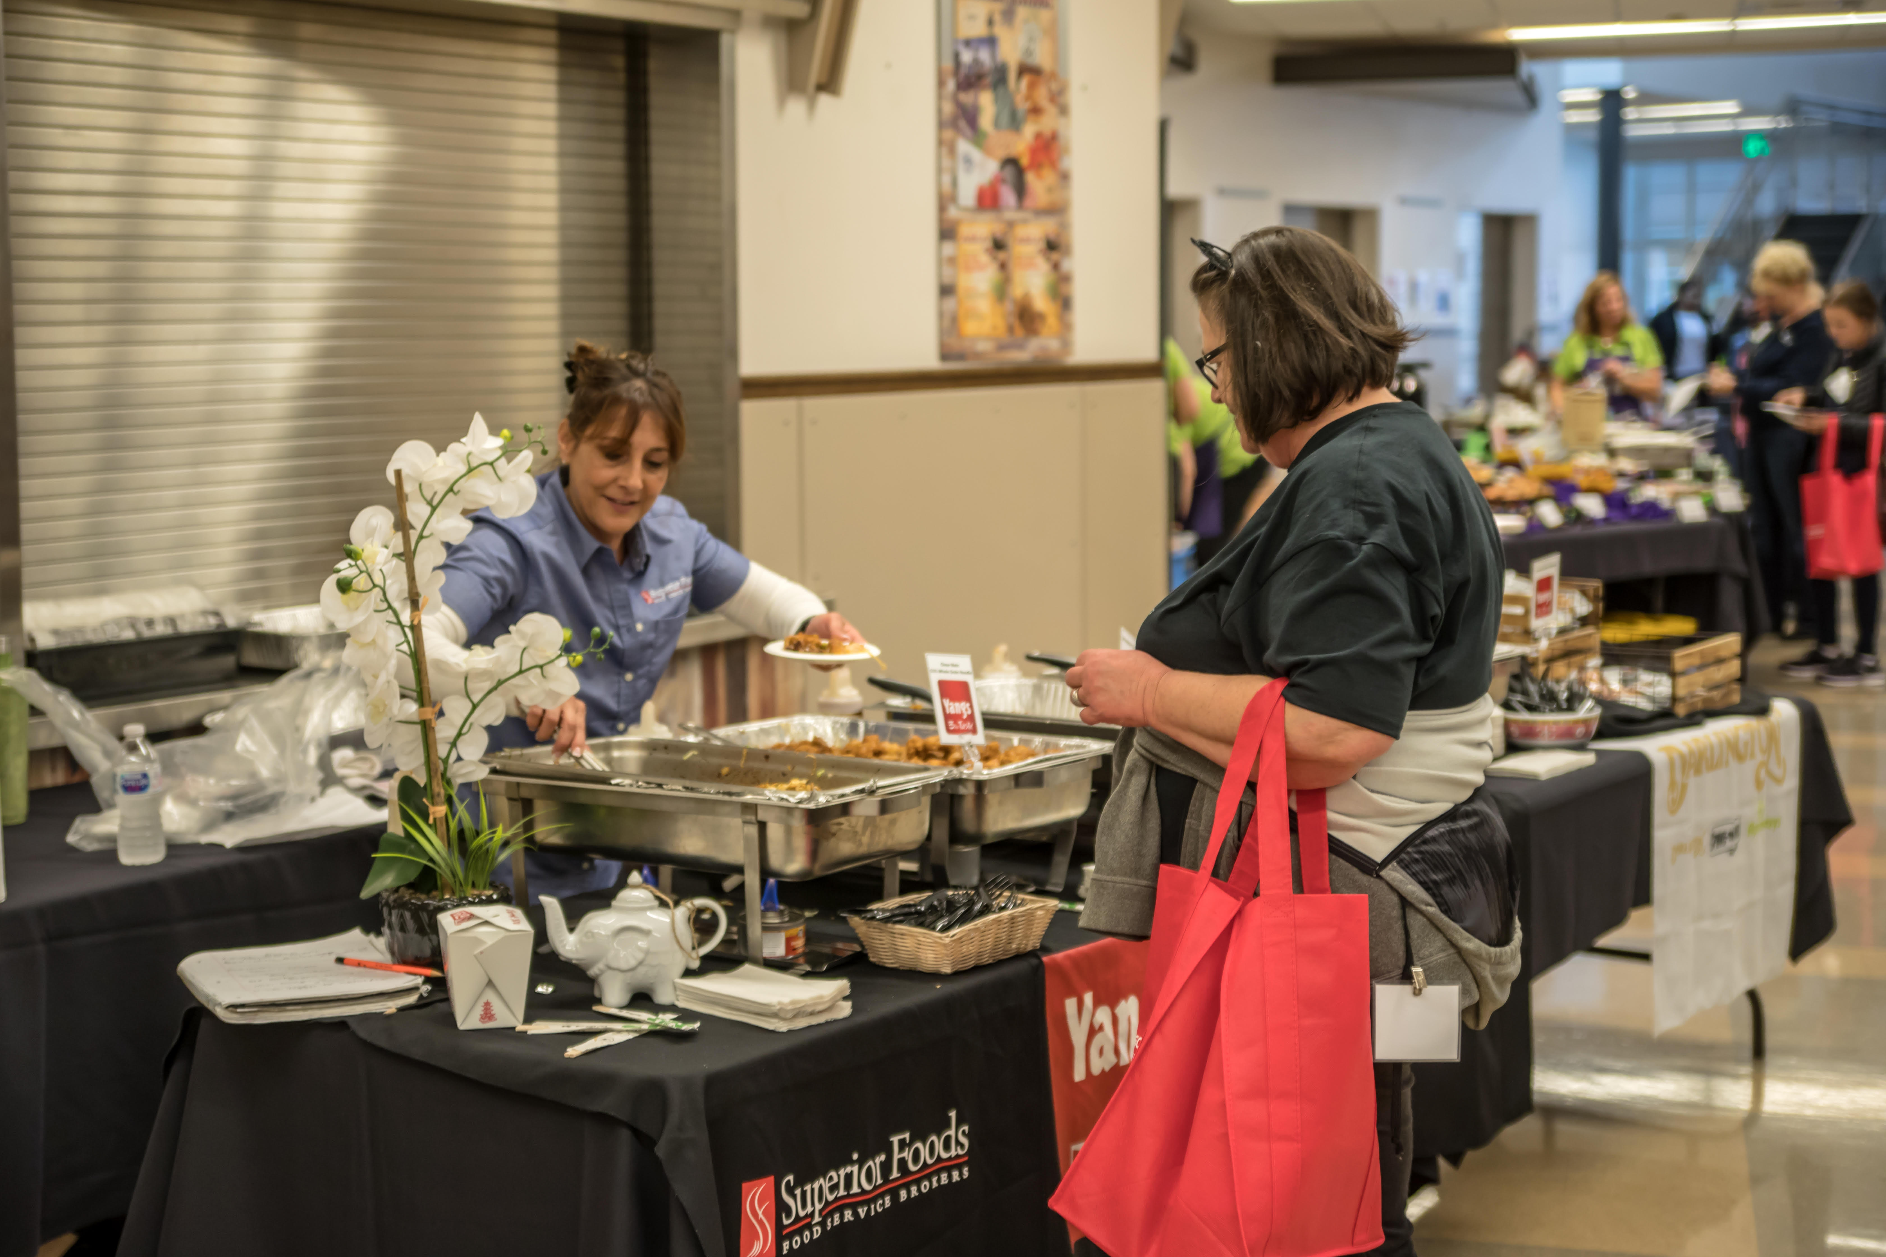
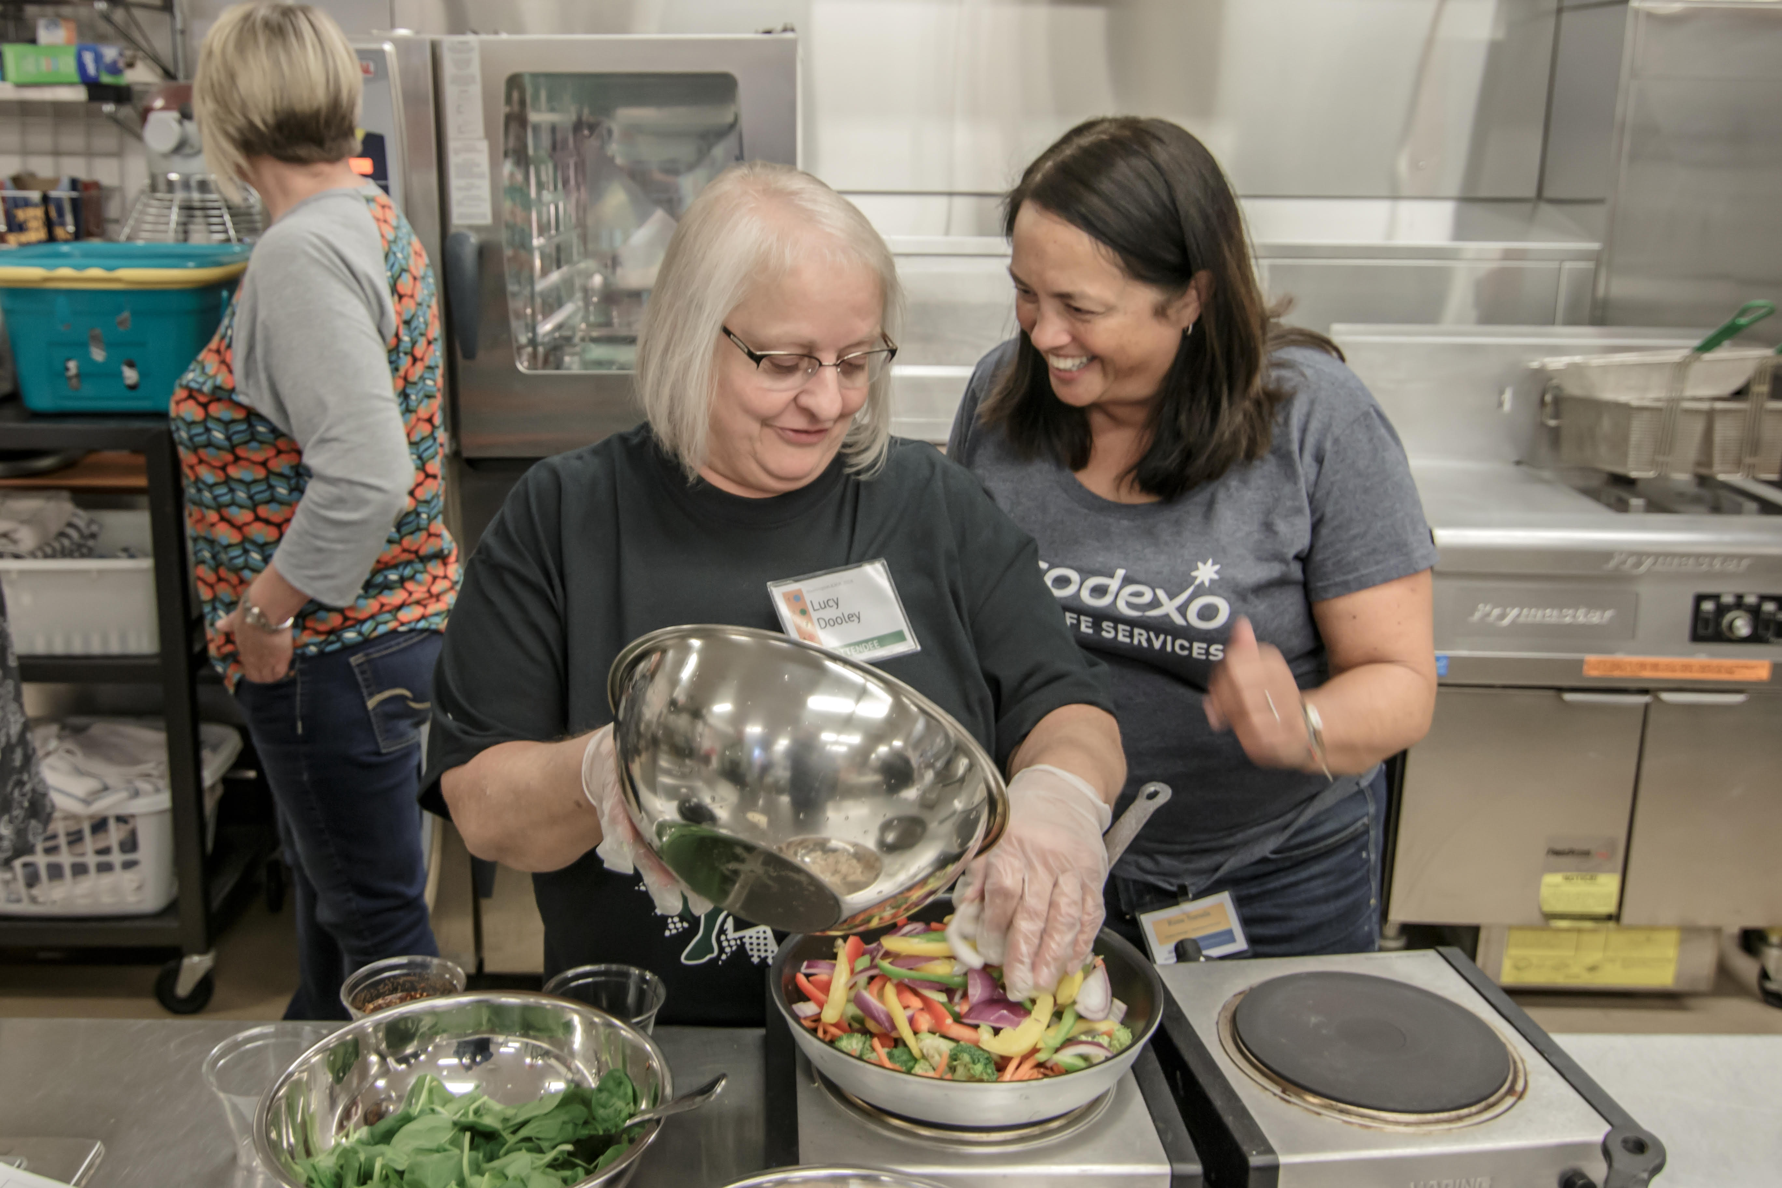
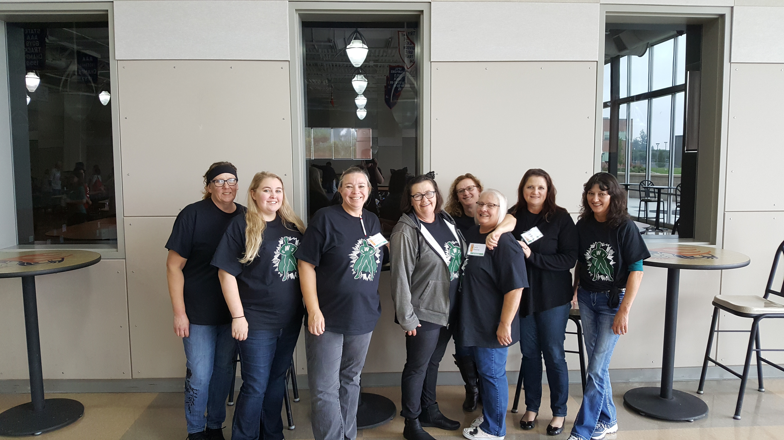
KITCHEN MANAGER RETREAT!
This year we all traveled to Lakewood for our annual Kitchen Managers retreat!
This is an opportunity for everyone to connect with their peers across the state and learn new things.
We tried different vendor samples, marketing tips, show cases and cooking demonstrations and classes!

Slide 10
Plans for next year…
Continue A-Z bar at all elementary schools
Complete Captured another school
More Book give-a-ways and Lucky Tray Days for the elementary schools
Continue Future Chef Competition, will have all elementary and WMS included
Fine Dine event at North Fork, Columbia & Yale
Chef in the Classroom at all elementary schools
More interactive activities with students
Continue feeding kids with smiles on our faces ☺

